Slide 1
United Nations Regional Workshop on Data Dissemination and Communication
General Bureau of Statistics (GBS)
Rio de Janeiro, Brazil, 5-7 June 2013
Emerging User Needs and Requirements
“A walk through the Data Dissemination process at the General Bureau of Statistics – Suriname”
Ms. Fallon Lambert

Slide 2
Outline Presentation
Background information on Suriname
Background information on the GBS
GBS Principles: Vision, Mission, Core Values and
The Data Dissemination Policy
Data Flow GBS
Selected Surveys
Statistics Producing Departments
Data Dissemination at GBS
Data Dissemination Strategies
Dissemination Difficulties for the GBS
Emerging User Needs
Micro – Data
What can GBS do to fulfill User Needs?

Slide 3
Background Information
Suriname
General Bureau Of Statistics

Slide 4
GBS Principles: Vision, Mission, Core Values and The Data Dissemination Policy
Vision: The General Office of Statistics will be an ongoing learning organization that functions optimally as coordinator and major producer of adequate statistics within the National Statistical System of the Republic of Suriname.
Mission: Provide the Surinamese and international community with proper statistics that give insight into the demographic, economic and socio-cultural situation and development of Suriname.
Core Values:
Servitude, Impartiality, Expertise
Integrity, Quality, Team spirit
Data dissemination policy:
Based on Statistics Act (SB 2002, no. 97), UN Fundamental Principles of Official Statistics and CARICOM-SCCS Position on Access to Micro Data

Slide 5
Data Flow GBS
Data Providers
Data Users
Government
Companies
Households
Students
Scientists
Researchers
(Trade) unions
Companies
Government
National organizations
International organizations
QUESTIONNAIRES
CRITIC
RESPONSE
Collect Data
Data Processing
Analyse
Publish

Slide 6
Selected Surveys
Census (2004 and 2012)
Household Budget Survey (2007/2008 – 2013/2014)
Continuous Household Survey (Quarterly, running since 1986)
Establishment Census (2007 and 2015/2016)
Establishment Survey (Annually and quarterly)
Consumers Price Index (Continuous price Surveys)
International Comparison Program (ICP) (2011/2012)
MICS (2006 and 2010)

Slide 7
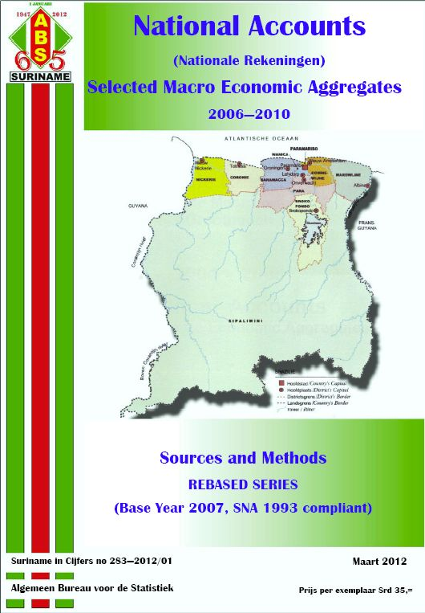
Statistics Producing Departments Published Data - Economic Division:
National Accounts
GDP Sheets (Yearly)
National Accounts publication (Every 2 years – 2012)
Enterprise Statistics
Wages and Prices in the Construction Industry sheet
Wages and Prices in the Construction Industry Publication (Every 2 years 2011 and 2013)
Economic Statistics Publication (Every 2 years 2012)
Consumer Price Index
CPI Sheets (monthly)
Trade Statistics
Import and export statistics from shipping documents
Trade Statistics Publication (Every 2 years – 2008 and 2013)

Slide 8
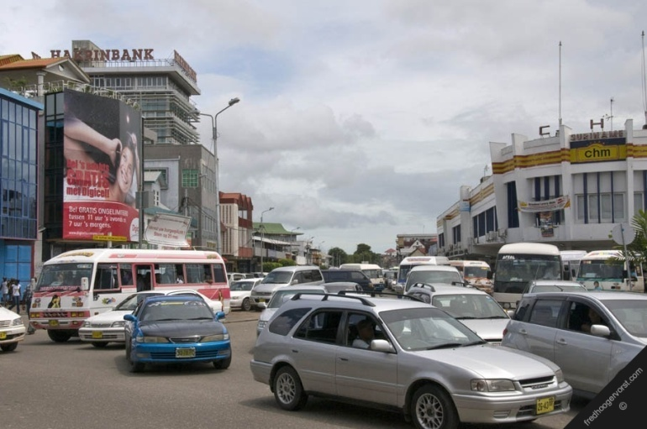
Statistics Producing Departments Published Data - Social Division:
Household Statistics
Households In Suriname publication (Every 2 years)
Population Statistics
Demographic Data publication (Every 2 years)
Transport and Traffic Statistics
Transport and Traffic Statistics publication (odd years)
Social Cultural Statistics
Statistical Yearbook Suriname (yearly)

Slide 9
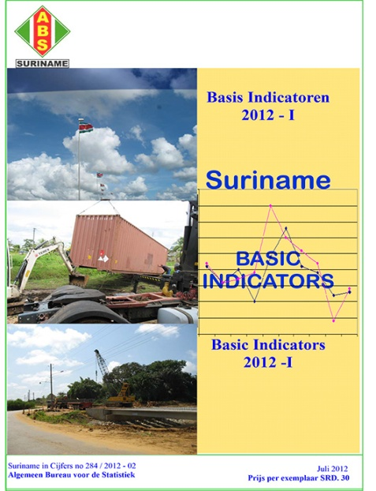
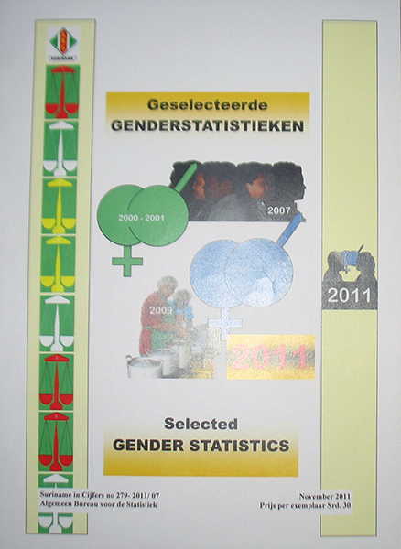
Statistics Producing Departments Published Data
Research and Planning:
Gender (2011 and 2013)
Environment (2012)
Basic Indicators (2x - 2012 and 2013)
Statistical Papers (Yearly – 2012 and 2013)
CENSUS:
CENSUSDATA

Slide 10
Data Dissemination at GBS
Public Relations and Information Unit
Website
E-Mail
Press Release
Publications
(Soft Copy - CD)
Press Conferences
Publications
(Hard Copy)

Slide 11
Data Dissemination Strategies
GBS provides the following:
Public Relations and Information unit
Internet Services
Official Website
E-mail Service

Slide 12
Dissemination Difficulties for the GBS

Slide 13
Emerging user needs
Distance between available statistical data and what user needs (not lower then resort level)
Describe how the data is produced / meta data for public
Users demand detailed small area statistics and micro-data (Confidentiality risks)

Slide 14
GBS and the Institute for Graduate Studies and Research (IGSR) – first step to… Micro Data
GBS IGSR
Letter of Understanding
Letter of Intent
GBS makes its produced metadata and Micro Data available to the IGSR.
In the near future both organizations will work together in analyzing and publishing research results.
Signed

Slide 15
What Can the GBS do to full fill the user needs?

Slide 16
Thank You
H. G. Wells “Statistical Thinking will one day be as necessary for efficient citizenship as the ability to read and write…”

